Slide 1
FLAGSTONE MEDICAL
Richard Sanchez, M.D.
Medical Director

Slide 6
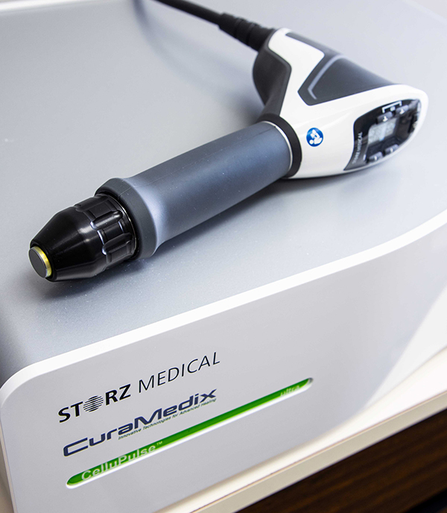

Slide 9
Lithotomy Position

Slide 14
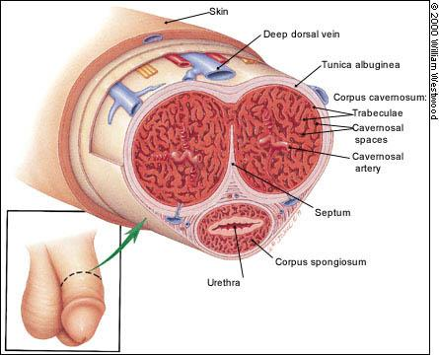

Slide 15
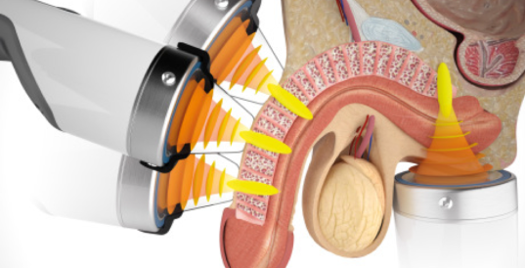

Slide 16
