Slide 1
PEYRONIE’S

Slide 3
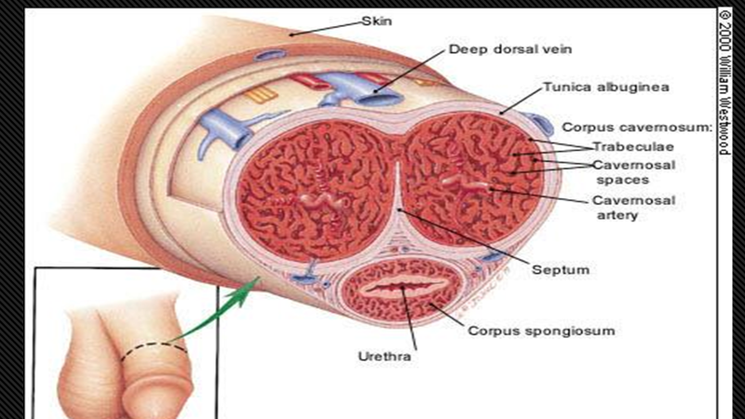

Slide 4
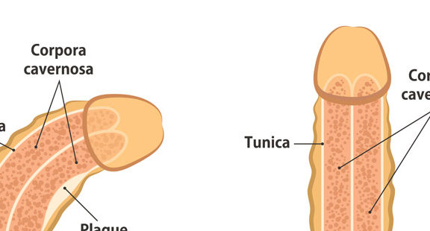

Slide 5
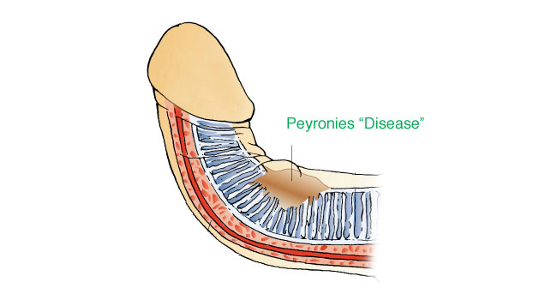

Slide 6
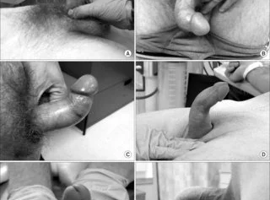

Slide 7
TREATMENT OPTIONS SURGERY (Invasive) XIAFLEX INJECTIONS (Invasive) ACOUSTICE WAVE THEAPY (Non-Invasive)

Slide 8
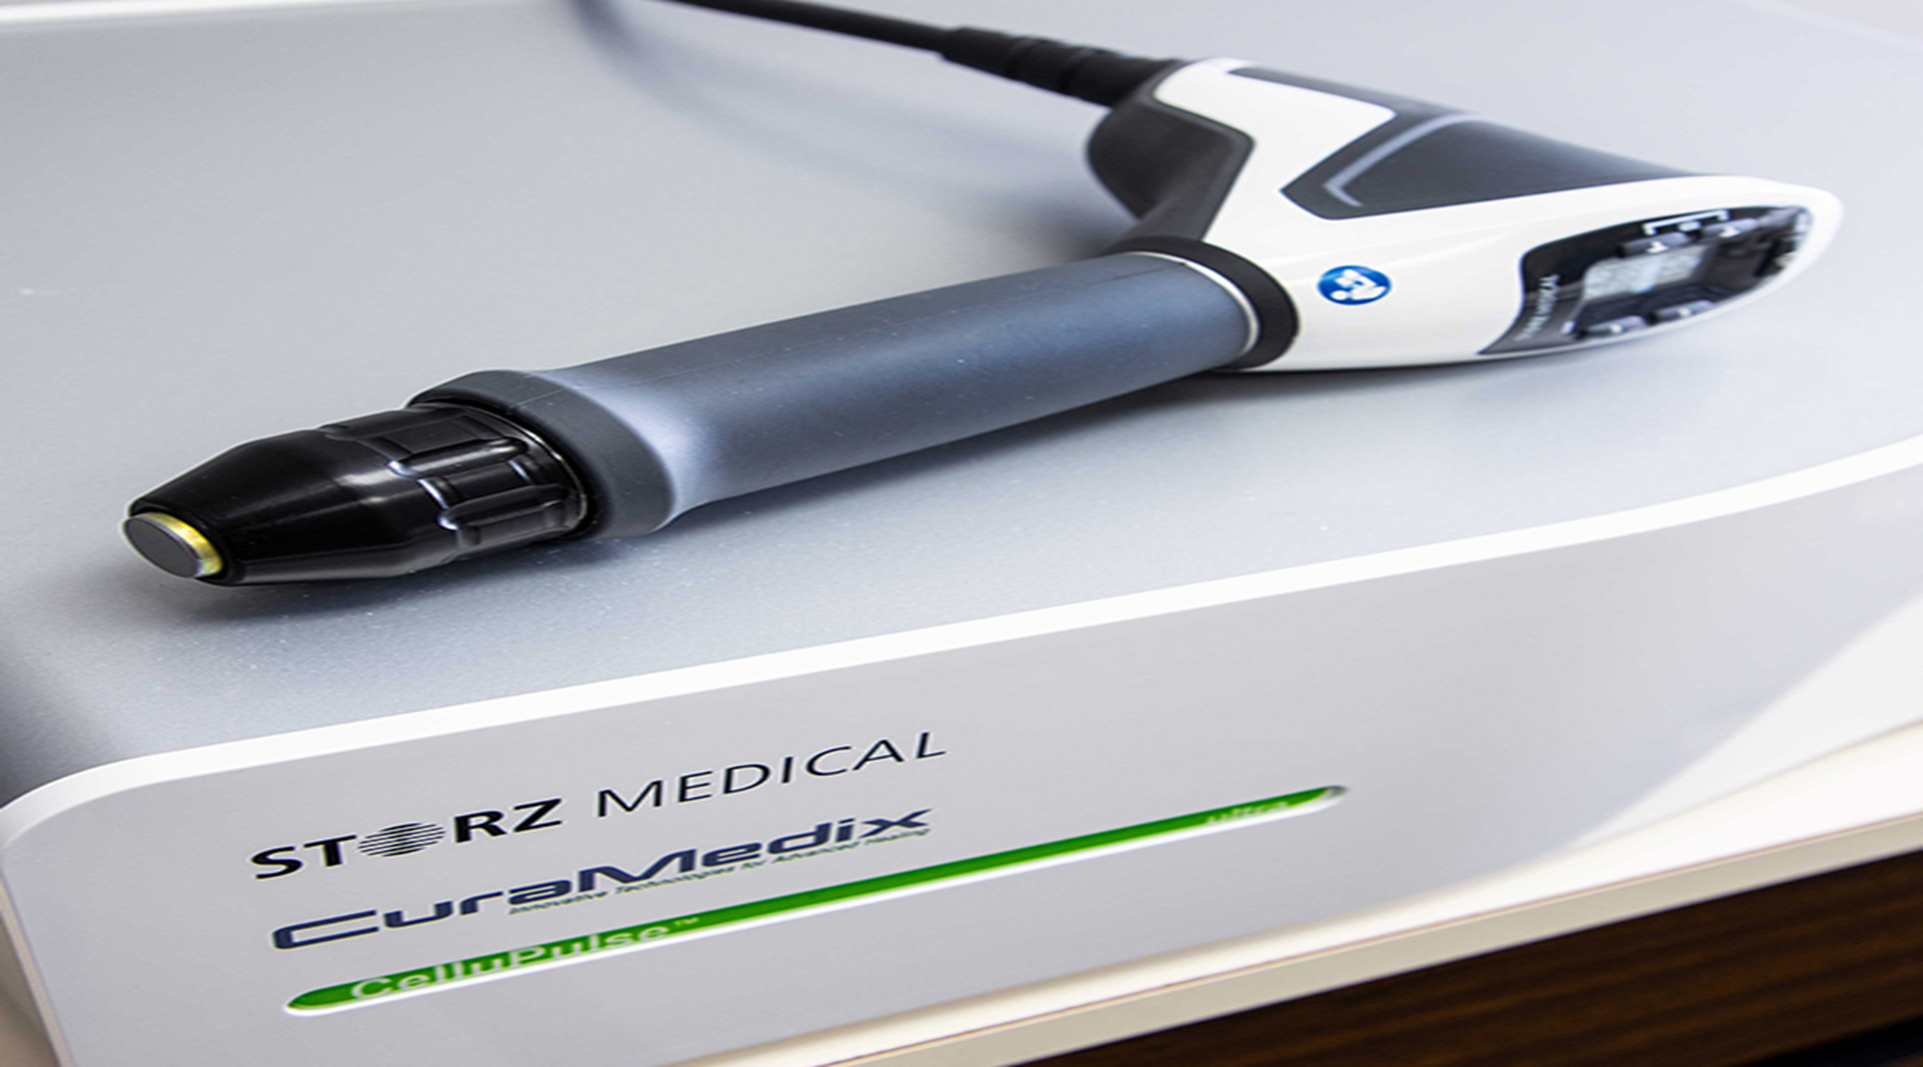
ACOUSTICE WAVE THERAPY

Slide 9
